Slide 1
TODAY
Another day of reaping the rewards of the work you have done so far
One important new idea – mutual reference / recursion
The “hard parts” won’t actually be very hard
just trusting recursions as usual
The easy parts will require learning some new details
minor housekeeping changes with @htdf organization

Slide 2
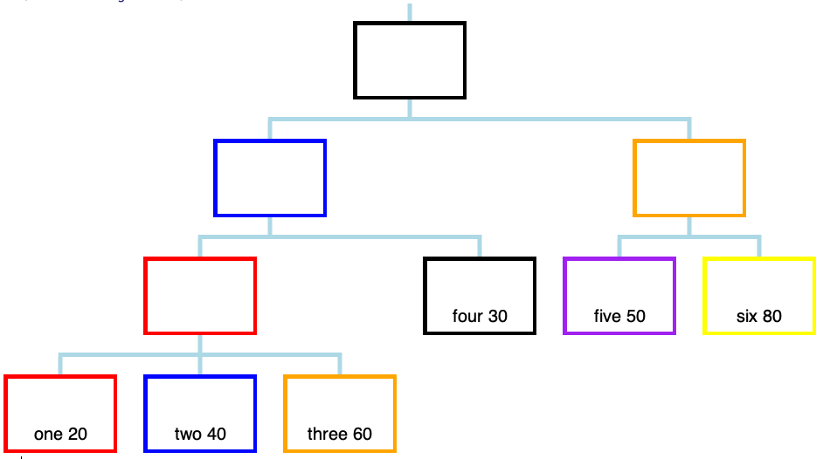

Slide 3
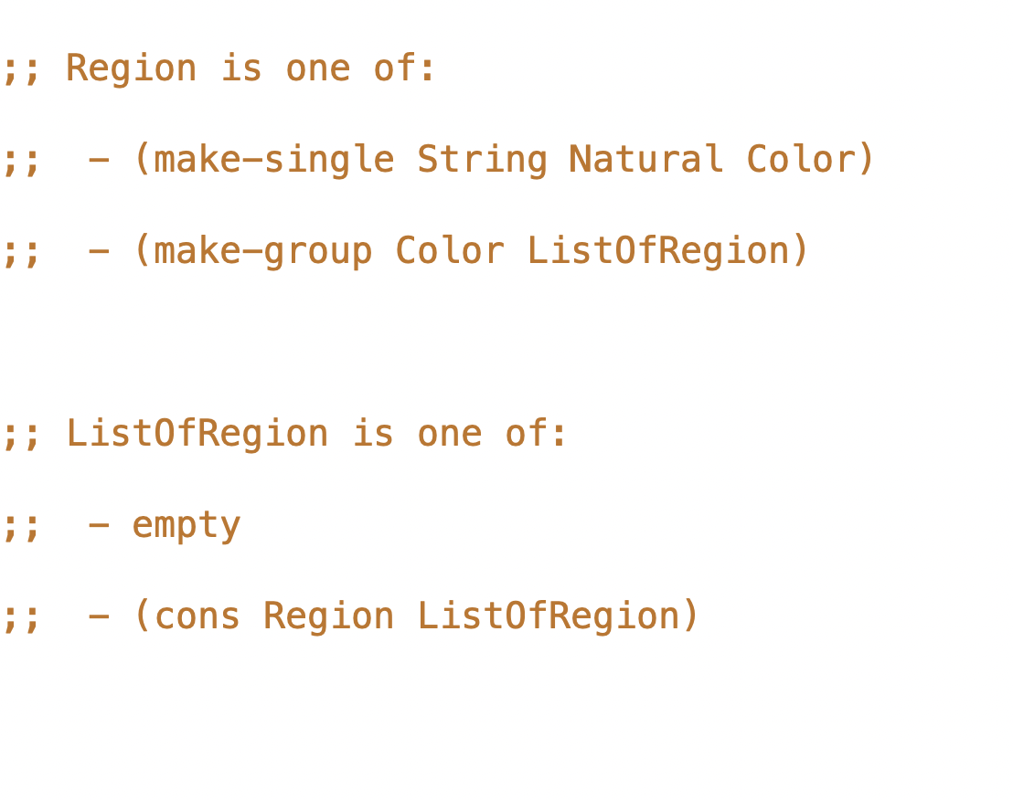

Slide 4
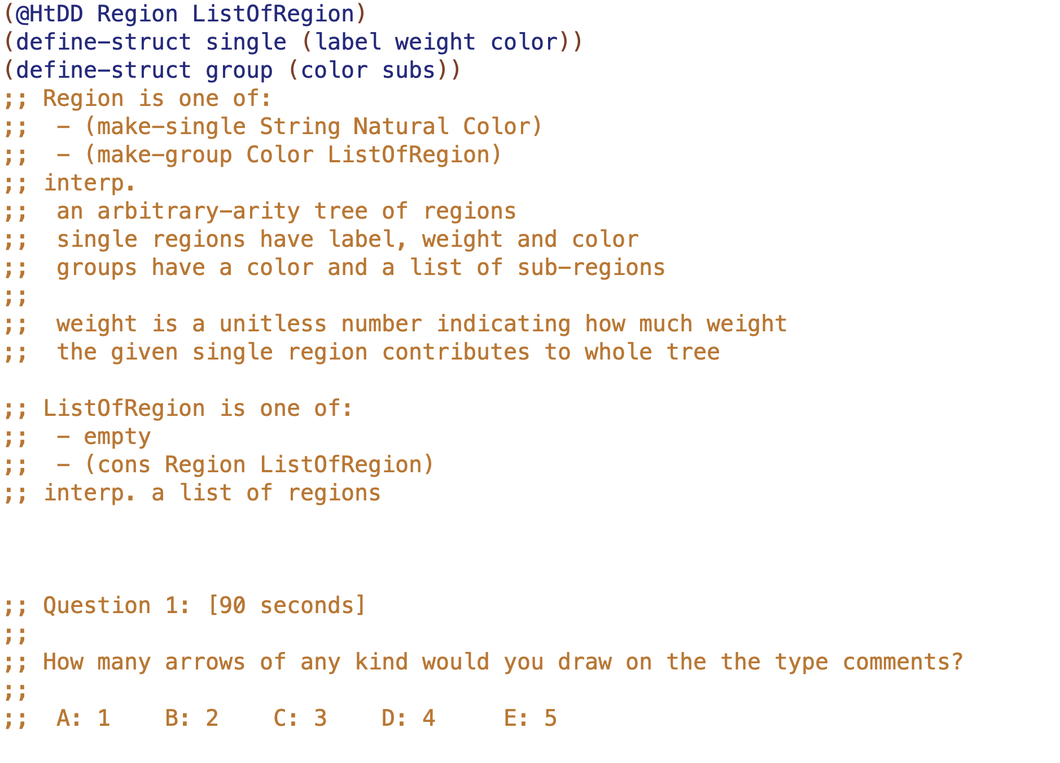

Slide 5
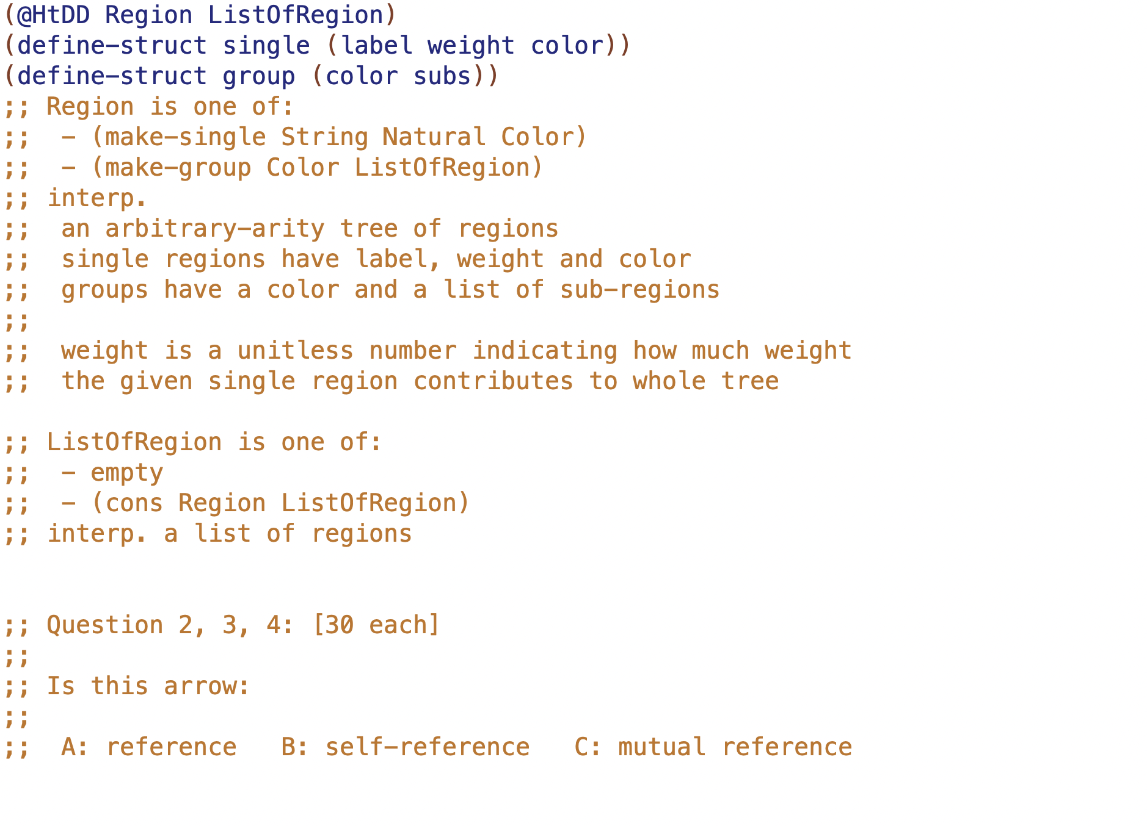

Slide 6
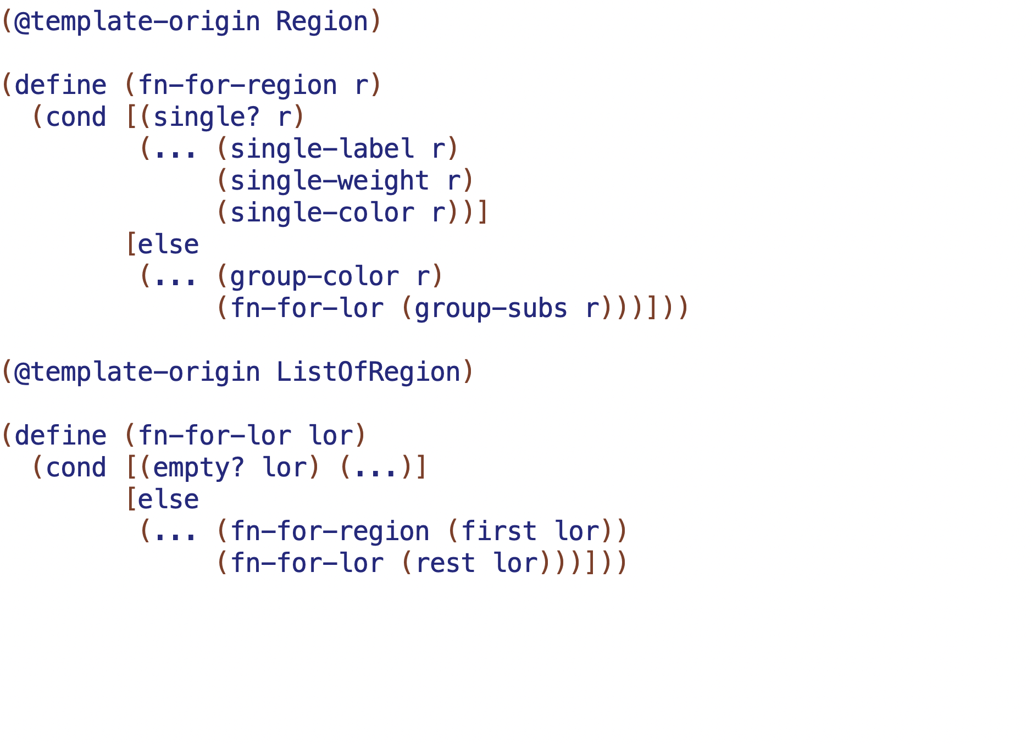
mutual reference means these functions come in pairs (2 or more in general)
NMR
NMR
NR

Slide 7
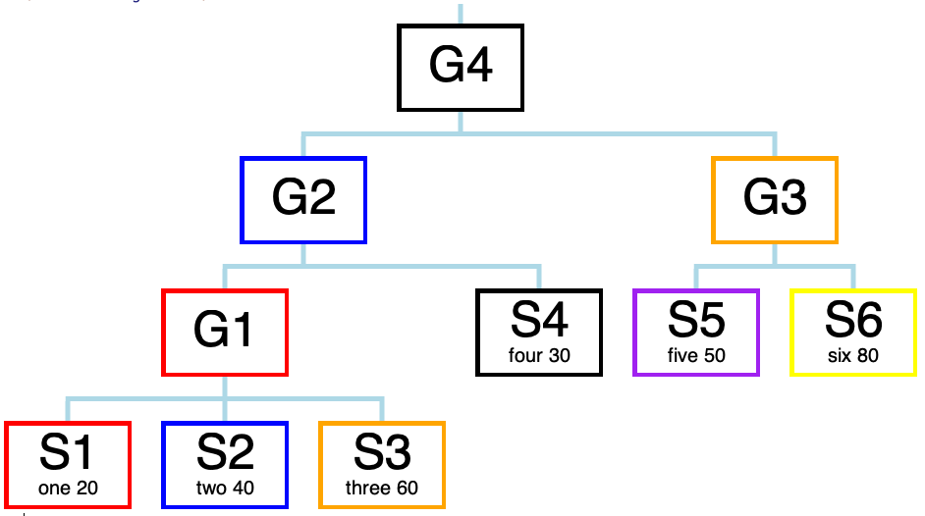
S1, S2, G4 etc. are the
NAMES OF THE CONSTANTS

Slide 8
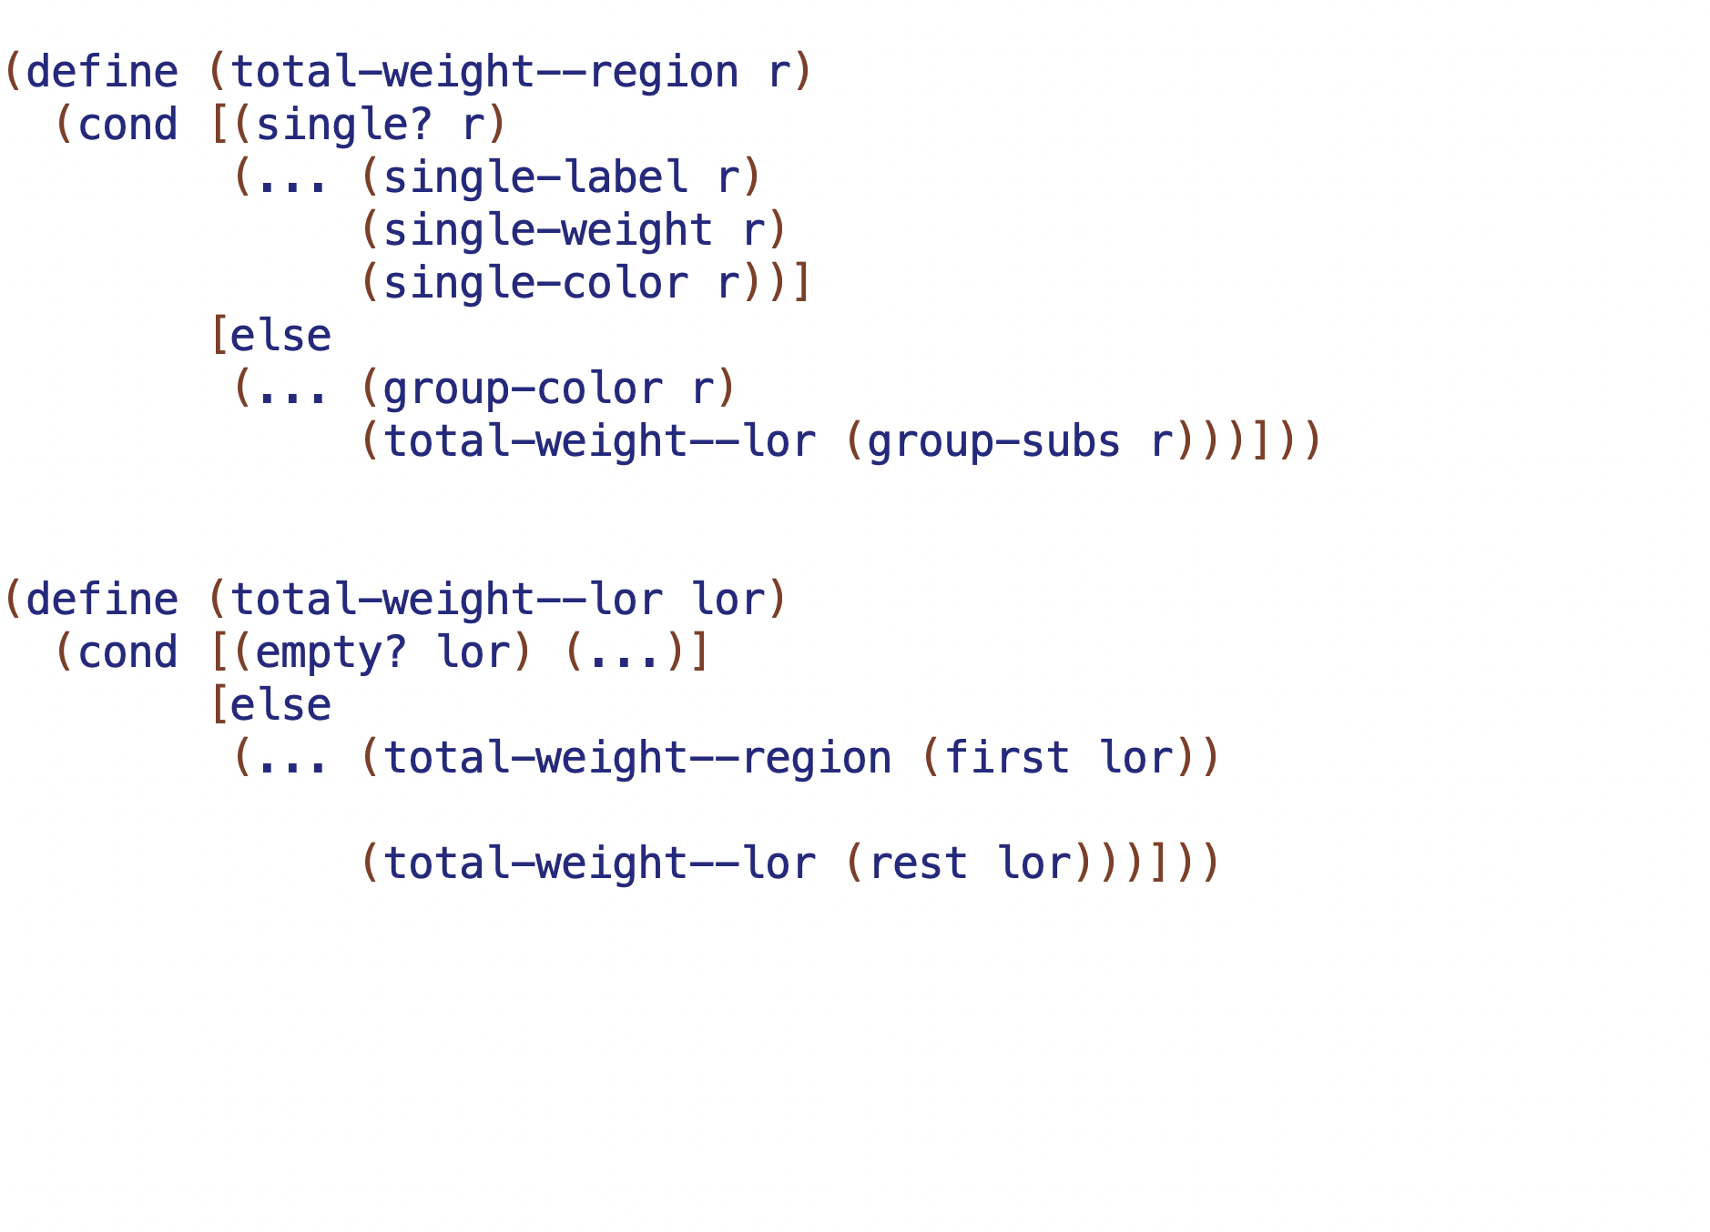
result will be?
result will be?
result will be?

Slide 9
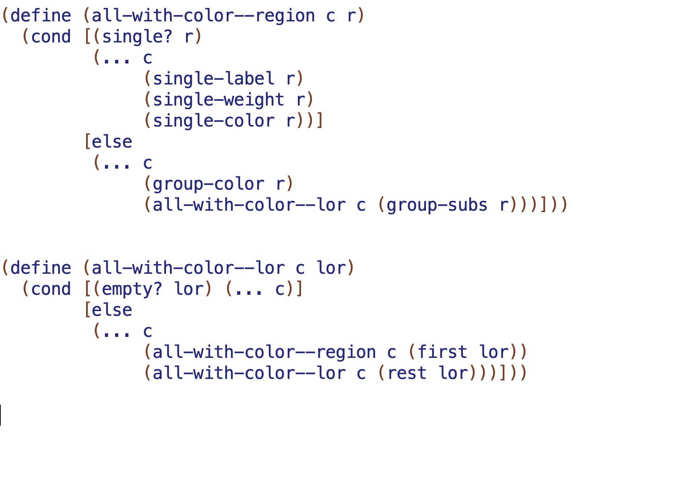
result will be?
result will be?
result will be?

